Slide 1
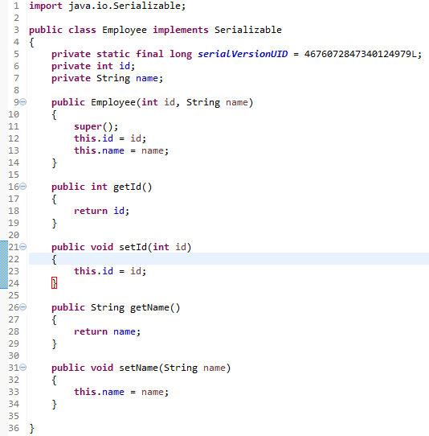
serialVersionUID
serialVersionUID is used to ensure that same class(That was used during Serialization) is loaded during Deserialization. serialVersionUID is used for version control of object.
If you have used Serialization then You might have seen serialVersionUID because whenever you implement Serializable interface your IDE will give you warning.
serialVersionUID must be Static and final. You can assign any number to it.
The serialVersionUID variable is used by Java's object serialization API to determine if a deserialized object was serialized (written) with the same version of the class, as it is now attempting to deserialize it into.
Imagine that a Employee object is serialized to disk. Then a change is made to the Employee class. Then you try to deserialize the stored Employee object. Now the serialized Employee object may not correspond to the new version of the Employee class.
To detect such problems a class implementing Serializable should contain a serialVersionUID field. If you make big changes to the class, you should also change its serialVersionUID value.
The Java SDK and many Java IDEs contains tools to generate the serialVersionUID so you don't have to. the default serialVersionUID computation is highly sensitive to class details that may vary depending on compiler implementations.

Slide 2
serialVersionUID
Disk
Serialized Employee Object
serialVersionUID=4676072847340124979L
Employee Object
serialVersionUID=4676072847340124979L
Serialization
DeSerialization

Slide 3
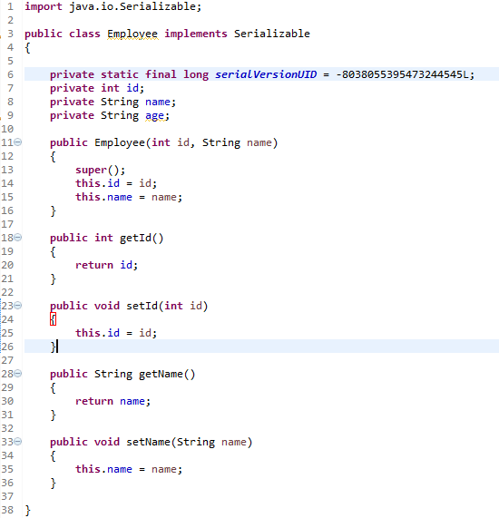
serialVersionUID
Disk
Exception in thread "main" java.io.InvalidClassException: Employee; local class incompatible: stream classdesc serialVersionUID = 4676072847340124979, local class serialVersionUID = -8038055395473244545
Serialized Employee Object
serialVersionUID=4676072847340124979L
Serialization
DeSerialization
So here during deserialization,we got error.It complained about Serialvesionuid being changed.But how does it know? because serialversionuid is a static variable and we know that "We can not serialize static variables".How does it store serialversionuid? yes ,there is exception.Inspite of serialversionuid being static,it get serialized.So ObjectOutputStream writes every time to output stream and ObjectInputStream reads it back and if it does not have same values as in current version of class then it throw InvalidClassException.

Slide 4
serialVersionUID
Why serialversionuid is required?
In real time,It is possible that you have serialized a object[i.e.Employee object] in a file and you deserialized it after few months on different JVM.In between class declaration[i.e. Employee class] has been changed.So it is a good idea to maintain version system and serialversionid does exactly same thing.It checks if you are deserializing same object[i.e. Employee Object] which you have serialized.

